Slide 1
12th UK Learning Analytics Network Meeting
University of Greenwich, 23 November 2017

Slide 2
Programme
10:15 – 10:25 | Arrangements for the day & welcome to the University of Greenwich
10:25 – 10:35 | Opening Address - Prof David Maguire, VC of Greenwich University and Chair of Jisc
10:35 – 11:00 | Update on Jisc effective learning analytics project – Dr Phil Richards, Rob Wyn Jones, Mark Harrington
11:00 – 12:00 | GDPR and consent for learning analytics - Andrew Cormack
12:00 – 13:00 | Lunch and networking
13:00 – 13:30 | Extracting learning analytics data from Turnitin - Suzanne Owen, Turnitin
13:30 – 14:15 | Understanding how predictive modelling works - Michael Webb
14:15 – 15:00 | Getting your data right for learning analytics – panel session
15:00 – 15:15 | Tea / coffee
15:15 – 15:55 | Learning analytics at the University of Greenwich - Dr Christine Couper, Karl Molden
15:55 – 16:00 | Farewell

Slide 3
Learning Analytics Service – now and next…
Dr Phil Richards - Chief Innovation Officer, Jisc

Slide 4
Joint exploration of existing Turnitin assessment data held, correlating with key Learning Analytics assessment data
Stage 1 Proposal (currently pre-contract) for KO January 2018
Collaborative effort working with a range of HEIs (opt-in, composed of current turnitin customers, some of who are current Jisc LA Pathfinder sites)
Analysing different HEI datasets, data items, relational data linkage for correlation with UDD/ data entities
Work together to see what opportunities existing to enhance learning analytics data, and explore other areas including academic integrity

Slide 5
SolutionPath Stream: Foundation Offer, covering a small number of qualifying sites for joint Jisc LRW & Stream Integration (January – July 2018)
Full integration of SolutionPath into Jisc’s Learning Analytics Architecture (UDD, xAPI)
Includes some elements of traditional Discovery and Readiness review within
Includes key technical foundation work and audit of institution data sources, and data integration requirements – including definition of initial analytics models
Output report and detailed view of proposed system, solution and processes – and scoping of solution trajectory included in an institutions Learning Analytics journey
Pre-production preview and testing of proposed solution, tailored to the specific institution
Approved LA supplier – discreet packaged services, via Jisc’s Dynamic Purchasing Service (DPS)

Slide 6
Data is powerful – let’s champion its use to support student success!

Slide 7
UK Learning Analytics Service – Summary

Slide 8
Learning Analytics - Service Update
Rob Wyn Jones - Senior Data & Analytics Integrator / Lead - UK Data & Analytics Service

Slide 9
UK Learning Analytics Service – Summary
Beta Service active – until 31st July 2018 (transition to service)
Fully supported service, with dedicated helpdesk (SLAs TBC), user groups & product development roadmaps
help@jisc.ac.uk – Live from 1st December 2017
Currently 18 Pathfinder Institutions (15 HEIs, 3 FE colleges)
17-18 free of charge pilot (pathfinder) ~ 15 spaces available in 2018
Full Learning Analytics Service from 1st August 2018 – charged to all institutions
Continued development of Data Explorer & Study Goal
Expanded portfolio of Vendors & Suppliers – more quality, more choice
Continued support of the Learning Analytics Network and Community

Slide 10
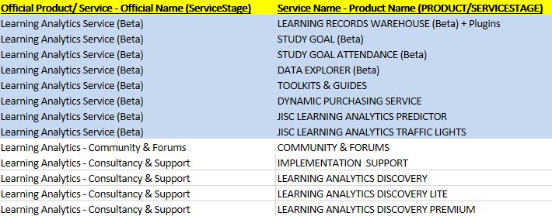
UK Learning Analytics Service – Inclusive Offering

Slide 11
Learning Analytics Service Cost
2018-19
Jisc HE & FE Members – free of charge until July 2017 (cut-off 30th April 2018);
HE Members: annual fee for 2018-19 based on an institution’s undergraduate students headcount, as denoted within their previous academic year HESA return;
FE Members: charge under discussion for 2018-19;
Costing for HE 2018-19: £5k base price + £1.80 per student (up to first 15k students) then £0.50 per student above that;
Inclusive single ‘Bundle’ service offering;
There is no charge for supplier access to data;

Slide 12
LRW, Data Standards & Technical
Unified Data Definition v1.3.2 now LIVE, support for UDD 1.2.x until 31 July 2018
Exclusive Pathfinders Basecamp (online discussion portal) now live
New plugins for Moodle (v1.02) and Blackboard (live and in service)
UDD Validator – bug fixes (includes fixes to data importing), enhancements to data quality reports, file conversion tools eg. TSV to JSON, SQL Schema & Data Fetchers, Angular 5 porting (lightweight & more responsive web application)
Work continuing well on the JLAP (Jisc Learning Analytics Predictor) in preparation for imminent pilot roll-outs with 5 HEIs
Positive discussions ongoing with Canvas (VLE) for LRW integration (xAPI)
Regular UDD data synchronisation and loading from institutions into the LRW now in place – error reporting/ log access and push alerts to institutions due
Data Explorer – Integration of basic case management/ CRM functionality coming soon…

Slide 13
Contacts
Phil.Richards@jisc.ac.uk
Rob.Jones@jisc.ac.uk
Michael.Webb@jisc.ac.uk
http://www.analytics.jiscinvolve.org
Join: analytics@jiscmail.ac.uk

Slide 14
Jisc’s Learning Analytics Purchasing Service
Mark Harrington – Co-design manager

Slide 15
Learning Analytics Purchasing Service
What is it?
An online procurement portal for products, services and infrastructure that’s compatible with the Jisc Learning Analytics Service
How is it different to other procurement frameworks?
Dynamic
Supported by a carefully drafted contract structure
Why use it?
To add value at all stages in your data and analytics journey
Who's in the Purchasing Service?
Initial batch of 11 suppliers have been accepted
Working with others who are preparing to join

Slide 16
Contacts
mark.harrington@jisc.ac.uk
Guidance on use of the Purchasing Service:
https://docs.analytics.alpha.jisc.ac.uk/docs/learning-analytics/Learning-Analytics-Purchasing-Service

