Slide 1
Learning Analytics & Learning Design
Patrick Lynch
p.lynch@hull.ac.uk
@thebigparticle

Slide 2
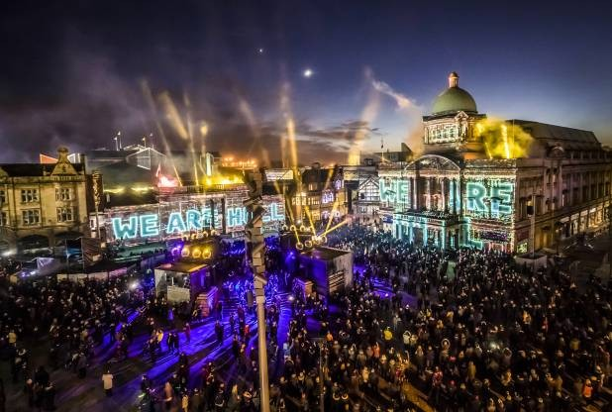
UK City of Culture 2017-20
Notes:
University of Hull lead party in the UK City of Culture

Slide 3
OA Dashboard
OA LAP
OA LRS
Apereo Software Communities
Notes:
Apereo open source foundation
A range of communities – including Xerte which most folks will know
Its not just for developers

Slide 4
Agenda
Learning Analytics, where am I coming from?
why the emphasis on Learning Design
so what?
what next?

Slide 5
Learning Analytics: where am I coming from?

Slide 6
A plug
Sclater, N. (2017). Learning Analytics Explained. Routledge
Notes:
Chapter 6 – Learning analytics and curriculum design

Slide 7
2012
Notes:
Great work pulled some of this together from CETIS in 2012

Slide 8
Stages of analytics use
Predictive Analytics
What might happen e.g. use large amount of historical data to create predictive models
Automated Analytics
What is happening e.g. Set “rule” to trigger alert if grade drops below a certain level
Basic Analytics
What has happened e.g. HESA returns

Slide 9
So what has changed?
5 Vs of Big Data
Volume
Velocity
Variety
Variability
Veracity
Or was that 7 V’s?
Visualisation
Value
aVailability
Notes:
Variety – not just structured data, text, image audio … qualitative
Value – turning it into value
No source it seems everywhere and I can’t pin it down
Data from 2014
Volume
100 terabytes per day in Facebook
4 to from a self driving car
Velocity
300 000 tweets every minute
Variety – where is data coming from, text, image, voice …
Variability
Try the word ‘sick’ as an example. Making meaning is hard.
Veracity – accuracy of the data
And of course tools have emerged

Slide 10
Definitions of Learning Analytics
The measurement, collection, analysis and reporting of data about learners and their contexts, for purposes of understanding and optimizing learning and the environments in which it occurs. Siemens, G. (2011).
Analytics is the process of developing actionable insights through problem definition and the application of statistical models and analysis against existing and/or simulated future data. Cooper, A (2012)
Notes:
The first is nice in that it talks about learners and the learning environment and optimising these. Learners and their contexts.
The second for me crystallises that idea of actionable insights. We are looking for things to do. We have defined problems (questions) that we want to understand.

Slide 11
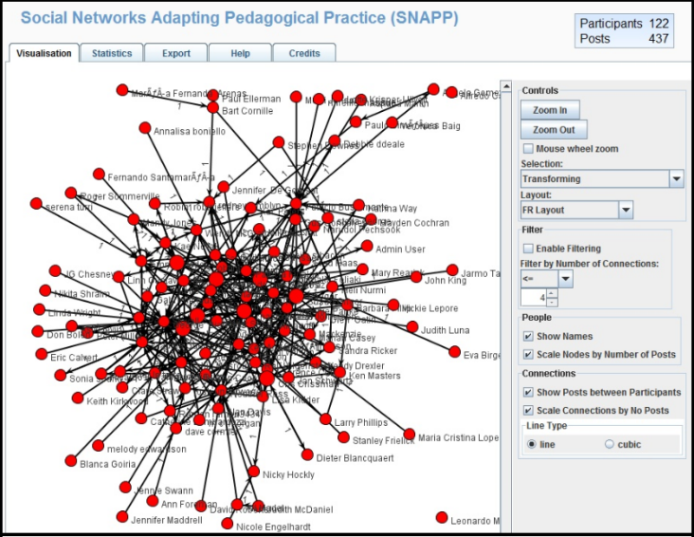
Descriptive versus predictive analytics
Notes:
Should learning analytics tools prompt instructors when learning outcomes are not being met?
The SNAPP tool integrates with an LMS forum to show teachers visualisations of how learners are interacting. In one evaluation of its use, the system was reported to be being largely used as a reflective tool, especially effective for analysing courses once they were completed. However, teachers were not using it to examine activity while the course was underway. This would have enabled immediate adaptation of the learning design if it was not functioning as expected.
Lockyer and Dawson suggest that additional functionality may be required to prompt instructors when the learning outcomes are not being met. For example, the development of a learning community may be an integral part of the learning design, but if students are not interacting as planned, the teacher needs to know that they should check the visualisations and take action to address the problem. Lockyer & Dawson, Learning Designs and Learning Analytics, p. 155.
I very much like descriptive analytics, not prescriptive. Focus on students and their contexts – not at this stage particularly excited about prediction

Slide 12
My journey

Slide 13
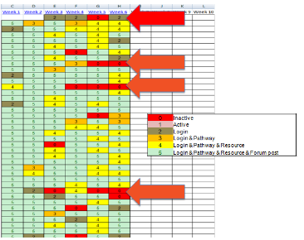
My journey
2012
2013
Notes:
ALT-C 2012 Lee & Scoble looked at a PGCert HE module.
The module required online use and they were interested in monitoring contribution to group work online
This did indeed present a confrontation with a hidden reality of what we actually do know about student activity
ALT-C 2013 Bridgeman, Gardiner & Lynch Analytics at the sharp end. Using excel to analyse and present simple correlation between expected activity and actual activity
Started with simple stas visualisation in Sakai – why had these students accessed a resource after the course finished?
Small data – it fit in Excel
Since then working on live (overnight link to VLE activity log)
Moved from 43 trackable events in the inbuilt statistics to 145 events in the system log.
Started using Tableau (prototyping) and R

Slide 14
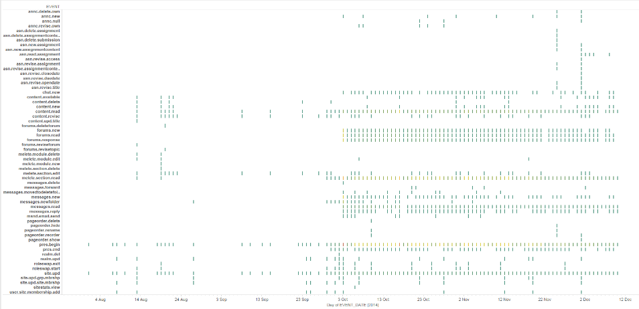
Course fingerprint
Notes:
Started to play with 25Million records from the VLE with an overnight update
But still it seemed that the greatest insight was at a smaller scale
To the left is lecturer activity

Slide 15
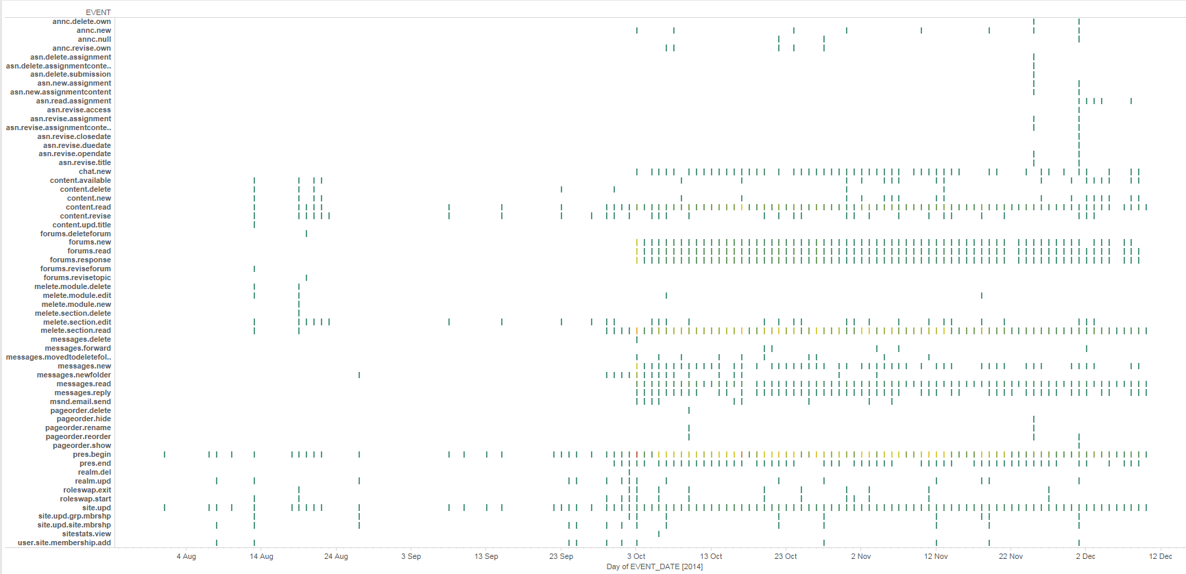

Slide 16
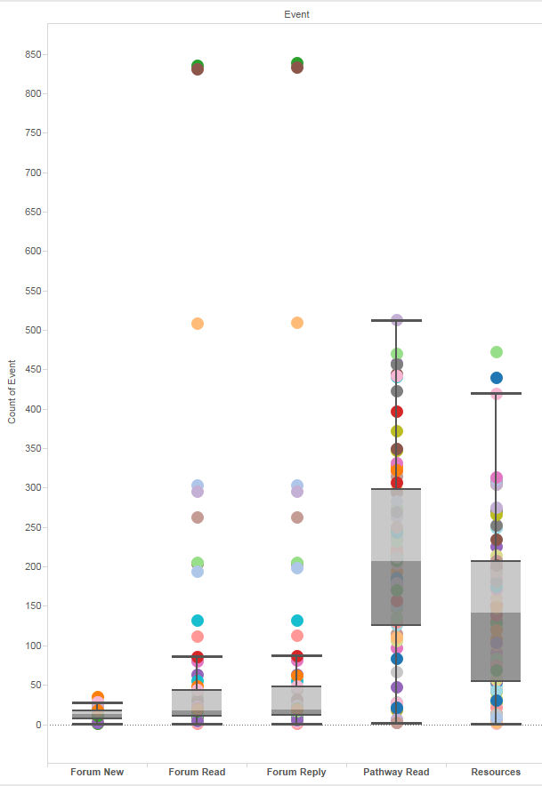
Patrick’s favourite
Notes:
Smaller view
Boxplot median, min, max, first and third quartiles
1st to 3rd is IQR 3 x that range are outliers. 1.5 IQR is the inner fence i.e. suspected outliers
That’s it for stats – because that didn’t work with students and it didn’t really work with staff
However I was having some great conversations with staff and students
I asked students what they wanted to know. We went through ‘I just want to know how I am doing’ to designing improvements in the course design.

Slide 17
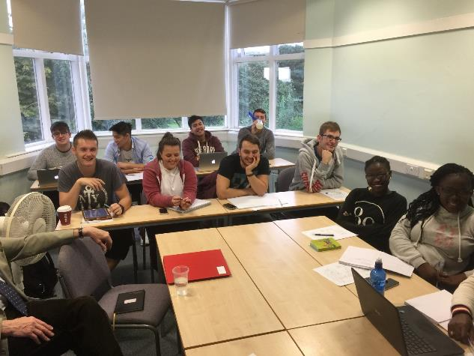
Notes:
I’m also interested in these people - learners

Slide 18
Agile development – students as product owners
(As a student) ‘I just want to know how I am doing’
Notes:
However I was having some great conversations with staff and students
I asked students what they wanted to know. We went through ‘I just want to know how I am doing’ to designing improvements in the course design.
We went AGILE
These students had no interest in competition and no student focus groups we worked with wanted any completion . Product owner need to work in between development and the users
BIG QUESTION – What is our goal – friends and family hospital survey – great satisfaction? Is that enough?

Slide 19
Learning design

Slide 20
Learning design
“We are moving from an instructional paradigm to a learning paradigm — from offering information to designing learning experiences ... from thinking about [courses and programs] as an aggregation of separate activities to becoming an integrated design.”
Bass, R. (2012)

Slide 21
Learning design
“A ‘learning design’ is defined as the description of the teaching-learning process that takes place in a unit of learning (e.g., a course, a lesson or any other designed learning event). The key principle in learning design is that it represents the learning activities and the support activities that are performed by different persons (learners, teachers) in the context of a unit of learning”
Koper (2006)
“not to transmit knowledge to a passive recipient, but to structure the learner’s engagement with the knowledge, practising the high-level cognitive skills that enable them to make that knowledge their own”
(Laurillard, 2008)
Notes:
Back in 2004 Rob Koper was looking at something called Educational Markup Language to describe learning, later with IMS to develop IMS-LD specification
Dianna Laurillard also recognised the importance

Slide 22
Carpe Diem
Salmon, 2011

Slide 23
Galley (2015)
Notes:
OU
Is light on students and reads as mostly pre implementation
5. Includes some analytics

Slide 24
Niall Sclater 2017
Notes:
Bigger picture
Where is the student?

Slide 25
Notes:
Looks like Kolb, simple, hides the complexity nicely
Learners as the key contributor
Metrics = analytics, visualisations, dashboards – actionable insight
Interventions – change the course add a session
Isn’t this learning design?

Slide 26
Context

Slide 27
Let’s not forget: Learning analytics are about learning
As a comparable analogy to teaching to the test rather than teaching to improve understanding, learning analytics that do not promote effective learning and teaching are susceptible to the use of trivial measures such as increased number of log‐ins into an LMS, as a way to evaluate learning progression. In order to avoid such undesirable practices, the involvement of the relevant stakeholders – e.g., learners, instructors, instructional designers, information technology support, and institutional administrators – is necessary in all stages of the development, implementation, and evaluation of learning analytics and the culture that the extensive use of data in education carries.
Gašević, D., Dawson, S. & Siemens, G. (2015)

Slide 28
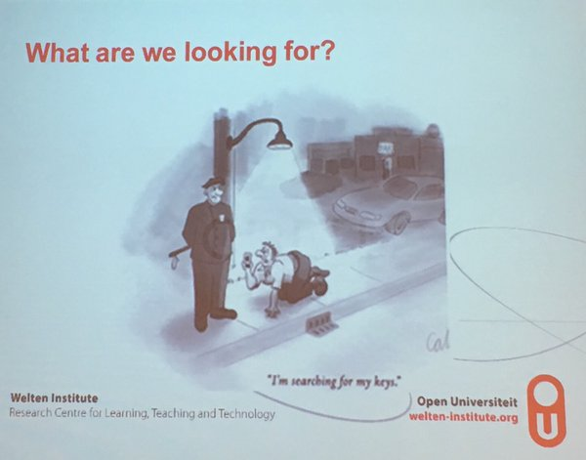
Evidence
Notes:
We are mostly using evidence that we happen to have found.
Does it answer the questions we have?
Good research design includes what evidence do we need, how will we capture it and how will we analyse it.

Slide 29
So what?
How do you know that the learning design is working??

Slide 30
“Throughout the history of education, the adoption of instructional programs and practices has been driven more by ideology, faddism, politics, and marketing than by evidence.”
Slavin (2008)

Slide 31
“it is bordering on the unethical to implement untried and untested recommendations in educational practice, just as it is unethical to use untested products and procedures on hospital patients without their consent”
Cohen, Manion and Morrison (2011)
Notes:
So we are looking to verify the learning design using LA
LD needs LA to validate itself, but can LA work without understanding the underlying LD?
One of the key texts on educational research

Slide 32
Faced with access to large collections of data and powerful open source analysis software, researches (sic) will be subject to a variety of temptations to poke about in this data in thoroughly unprincipled ways. While these fishing expeditions may uncover seemingly interesting relationships between constructs, without an interpretive framework grounded in specific theoretical commitments, the data tail may come to wag the theory dog.
Atkisson & Wiley (2011)

Slide 33
Research design approach
what is my research question?
is my learning design successful?
what data will I need to collect to answer that question?
how will I collect that data?
how will I analyse that data?
which patterns represent successful outcomes?
which patterns represent less successful outcomes/failure?
how can use the analysis to improve the learning design?
Actionable insights
Notes:
What are we trying to achieve?

Slide 34
7 Principles for good practice in undergraduate education
encourages contacts between students and faculty
develops reciprocity and cooperation among students
uses active learning techniques
gives prompt feedback
emphasizes time on task
communicates high expectations
respects diverse talents and ways of learning.
Evidence?
Chickering and Gamson, 1987
Notes:
So lets consider theses seven elements as things we might question – can we use data to help?
Chickering and Gamson US focus – colleague and I spent quite a bit of time trying to find a UK equivalent – no go
Can we measure these?
How would we need to design the learning to yield learning analytics? How can we analyse that data to inform actions?

Slide 35
How learning works: 7 Research-Based Principles for Smart Teaching
students’ prior knowledge can help or hinder learning
students’ motivation determines, directs, and sustains what they do to learn
how students organize knowledge influences how they learn and apply what they know
goal-directed practice coupled with targeted feedback enhances the quality of students’ learning
students’ current level of development interacts with the social, emotional, and intellectual climate of the course to impact learning
to develop mastery, students must acquire component skills, practice integrating them, and know when to apply them.
to become self-directed learners, students must learn to monitor and adjust their approaches to learning.
Ambrose et al. 2010
Notes:
Which of these are embedded in your designs or the designs you have experienced?
These look harder, partly because they are expressed more as design recipes than activity for the student, but we could break them into activities – can

Slide 36
Interventions: reactive design

Slide 37
Pedagogical intent
‘… the challenge posed by learning analytics is interpreting the resulting data against pedagogical intent and the local context to evaluate the success or otherwise of a particular learning activity’
(Dawson, Bakharia, Lockyer, & Heathcote, 2010).

Slide 38
Loop
Assessing whether “pedagogical intent” is reflected in student activity Corrin et al describe the development of a learning analytics tool, Loop, which was funded by the Australian Government’s Office of Learning and Teaching. This presents data to teachers on the interactions of students. Loop then uses data from the LMS to assess whether the intent is reflected in the students’ interactions, and presents this to teachers through dashboards and reports. Specifically, the tool integrates course structures and schedules in its visualisations to help evaluate the effectiveness of the learning activities.
Notes:
A tool for use with Moodle providing visualisations
2015

Slide 39
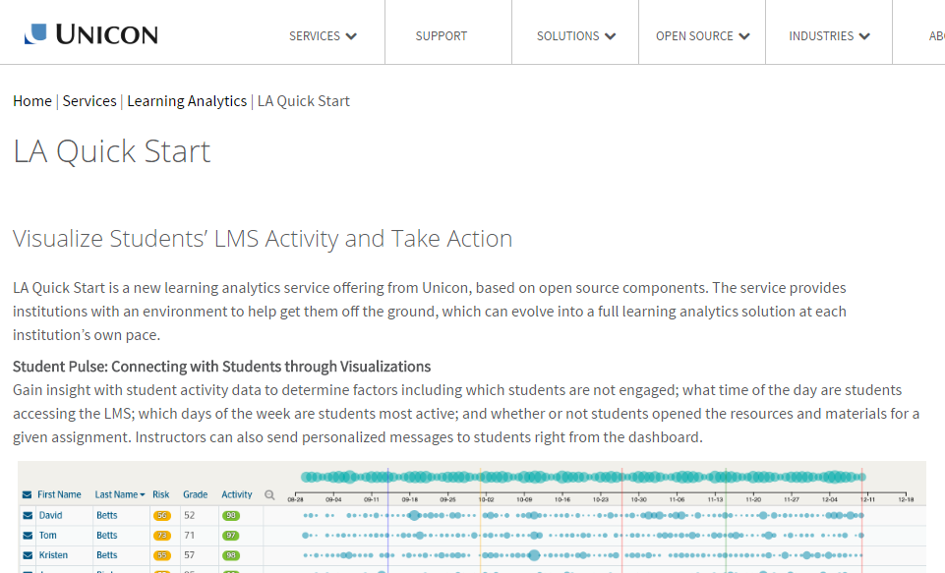
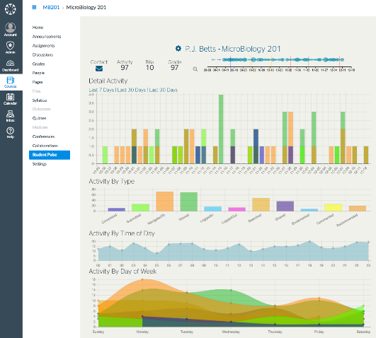
https://www.unicon.net/LA-quick-start

Slide 40
Context

Slide 41
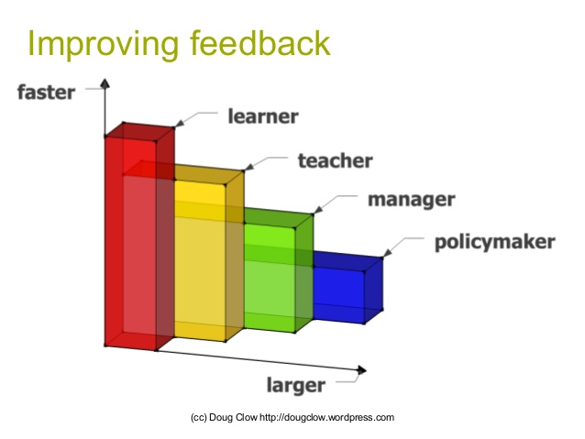
Becoming more agile
Notes:
Fastest student
How do we build analytics into the learning design
Niall talks about just-in-time changes made by the lecturer – the student is faster
Next lecturer
Agile teaching – feedback
Next the course
Based on feedback (not just words)
Next institutional
Remember my students who just wanted to know how they were doing?

Slide 42
What next?

Slide 43
For Learning Analytics and Learning Design
Arguably then learning design needs learning analytics in order to validate itself. However it also works the other way: learning analytics cannot be used effectively without an understanding of the underlying learning design, including why the particular tools, activities and content were selected and how they were deployed
Meanwhile it is clear that there is a growing necessity for the diverging communities of learning design and learning analytics to come together to develop languages and tools to address the full lifecycle of curriculum development and enhancement.
Sclater, 2007

Slide 44
Notes:
The world wide web wasn’t exactly all new stuff, it just brought things together
Many of the methodologies being applied to LA are not particularly new – text analysis, sentiment analysis for example. Our tools are just quicker and do a consistent job.

Slide 45
At Hull
design as a recognised activity
design goals clearly articulated
that identify the data and methodology up front
that builds knowledge through a set of LD patterns shown to work (or not) in given contexts
demand driven by TEF?
https://en.wikipedia.org/wiki/Ghostbusters_(franchise)#/media/File:Ghostbusters_logo.svg

Slide 46
#LTHEchat
Evidencing Practice for TEL
8-9 3rd May

Slide 47
Questions
p.lynch@hull.ac.uk @thebigparticle

