Slide 1
Where next for learning analytics?
Richard Burrows
Analytics Specialist
Blackboard International

Slide 2
Statements regarding our product development initiatives, including new products and future product upgrades, updates or enhancements represent our current intentions, but may be modified, delayed or abandoned without prior notice and there is no assurance that such offering, upgrades, updates or functionality will become available unless and until they have been made generally available to our customers.

Slide 3
Agenda
1
Adoption of Standards - for Insight Across Systems
2
Integration - Analytics insight are just part of the course
3
Automation - Analytics will drive automation in the course
4
Data Driven Interventions & Evidence based education
5
Cognitive Analytics

Slide 4
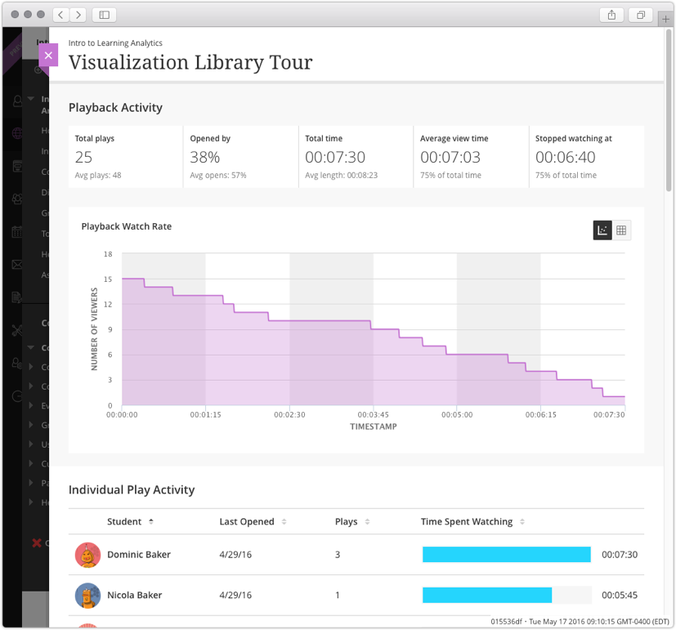
Adoption of Standards – Insight Across Systems
Integrated insights for teachers into what students are doing across tools and experiences
Kaltural Data in Blackboard Learn

Slide 5
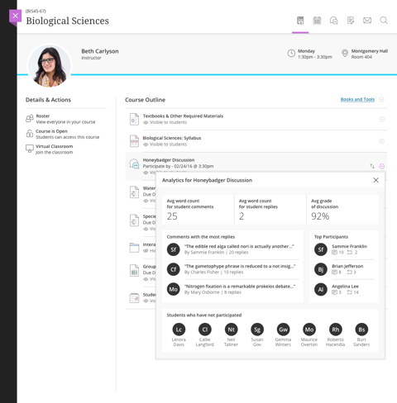
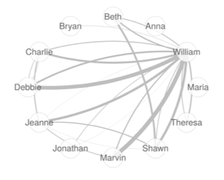
Analytics Integration: Discussion Insight and Action In development (Plan: March)
Conceptual mock-up subject to change without notice

Slide 6
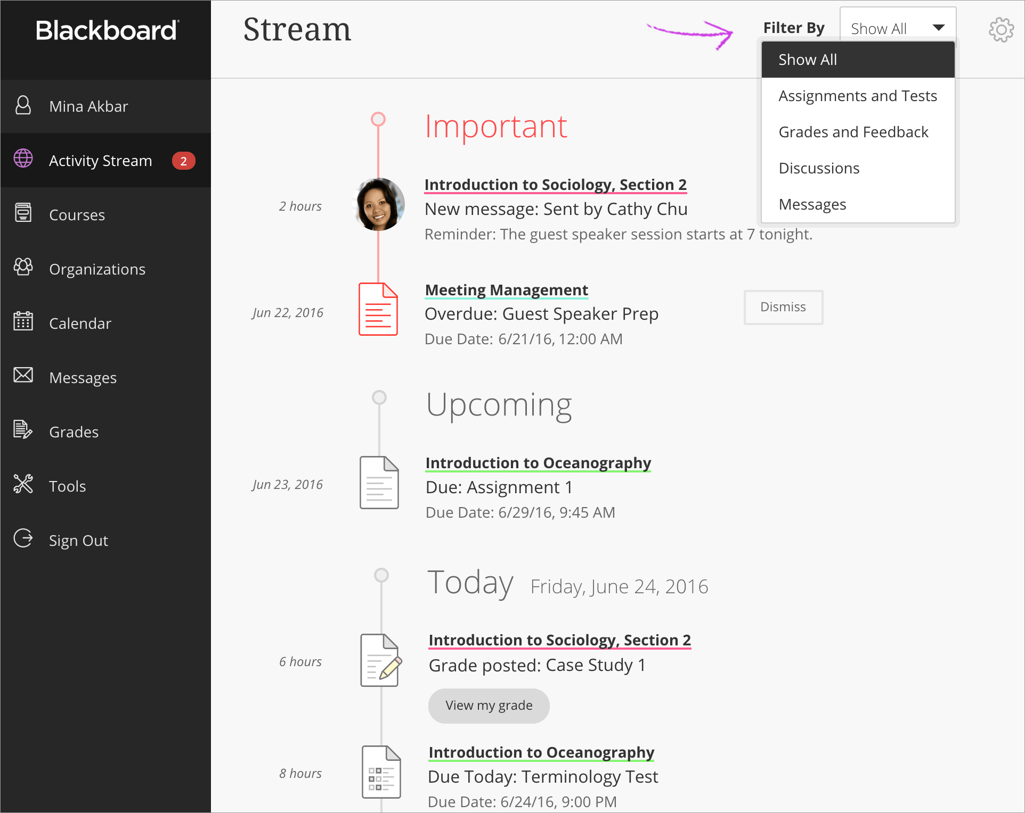
Analytics Automation - Nudging Behavior

Slide 7
Learner
Teacher

Slide 8
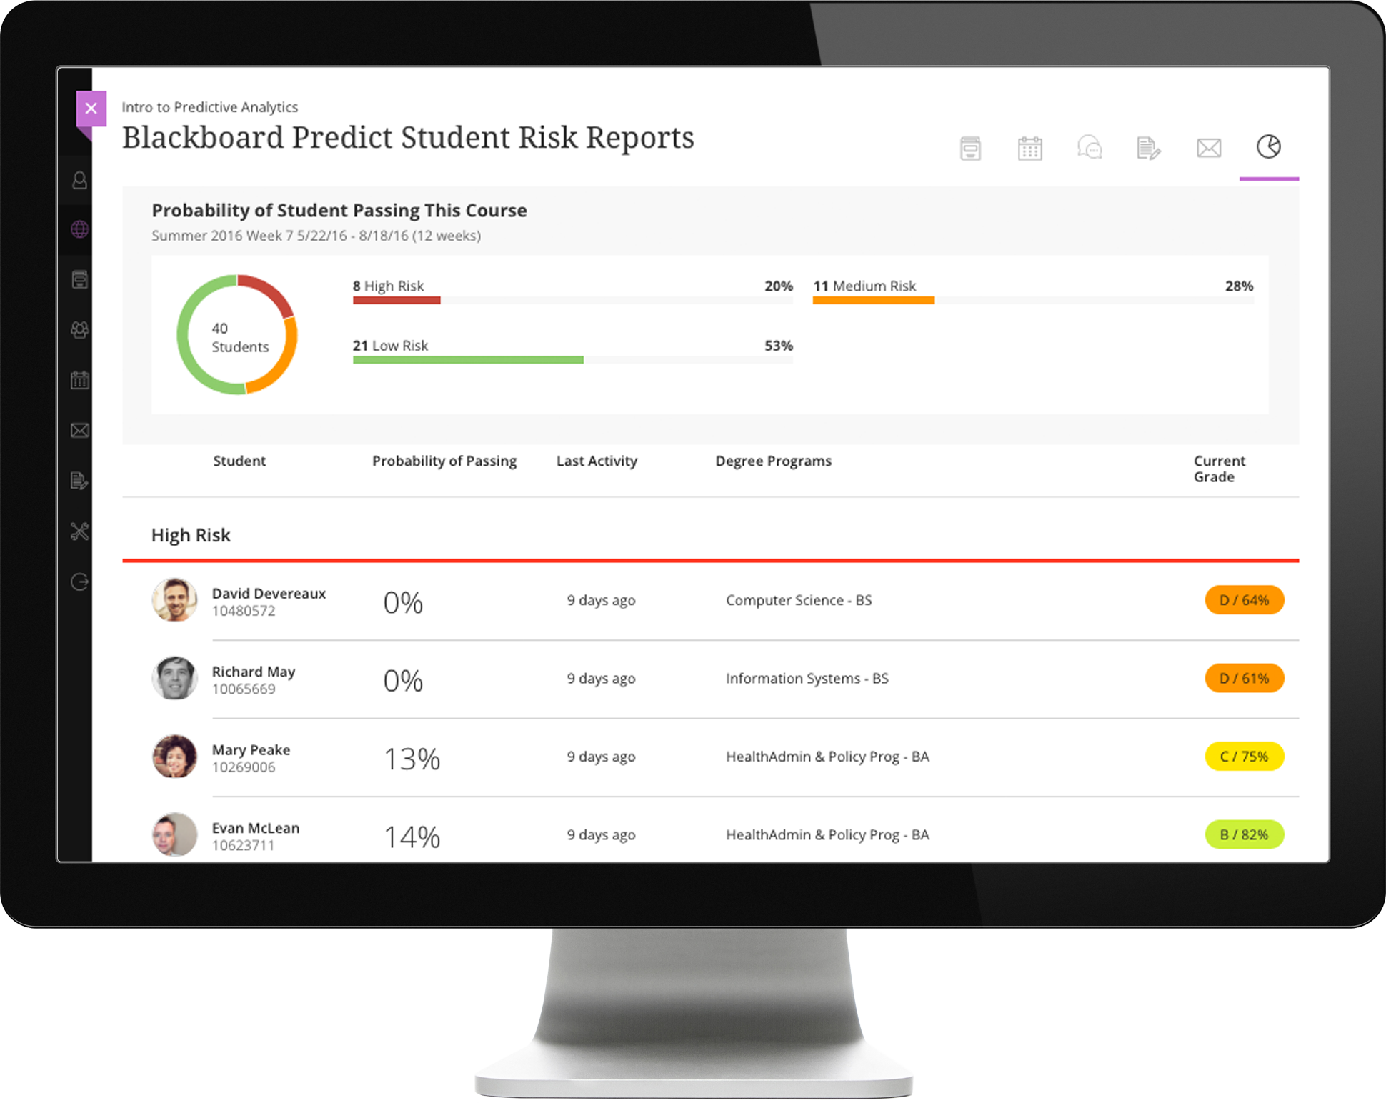
Data Driven Interventions Blackboard Predict

Slide 9
Automation & Integration – Cognitive Analytics

