Slide 1
Dysgu Dadansoddol / Learning Analytics

Slide 2
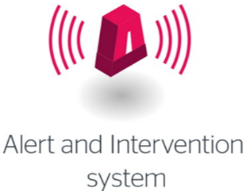
Strwythyr LA Structure
About the student (UDD)
Activity data (xAPI)

Slide 3
Cyfleusterau Cymraeg LA Welsh Services
Welsh language support – for all customer-facing LA services
Tribal Student Insight – front & back-end bilinigual
Translation templates available to institutions = local customisation
Local customisation facility & support during the LA pilot - inclusive!
Potential to develop automated translation/ access interface(s)
UDD 1.2 – requires customisation to provide extra bilingual fields (text)
https://github.com/jiscdev/analytics-udd/
UDD 1.2 – field options/ mappings to be translated – joint effort welcomed!
Useful translation resources:
http://geiriadur.bangor.ac.uk/
https://www.bangor.ac.uk/canolfanbedwyr/ap_geiriaduron.php.en

Slide 4
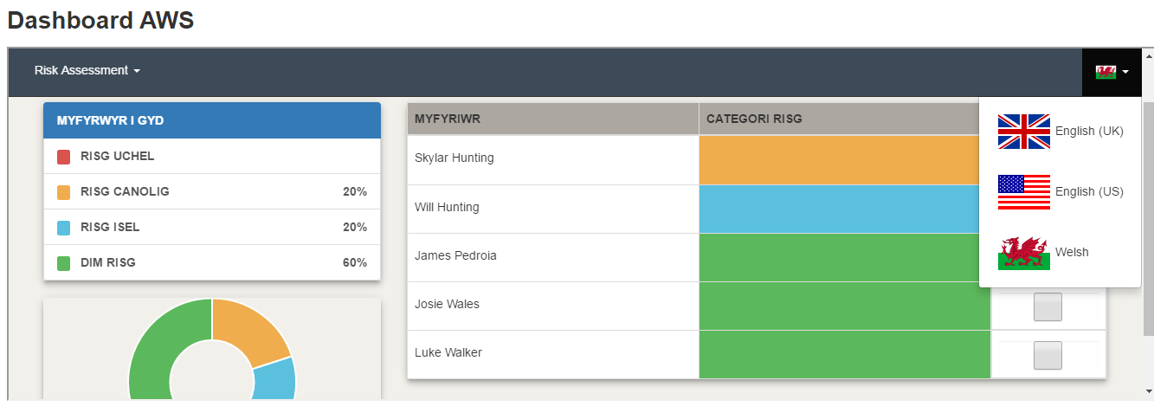
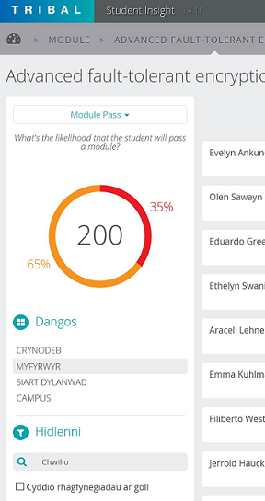
Arddangos Data LA Dashboards
UNICON OpenDashboard
Individual json files provided
translation underway recently
continuously updated
Tribal Student Insight
front & back-end welsh
single json file
515 terms translated so far…
continuously updated

Slide 5
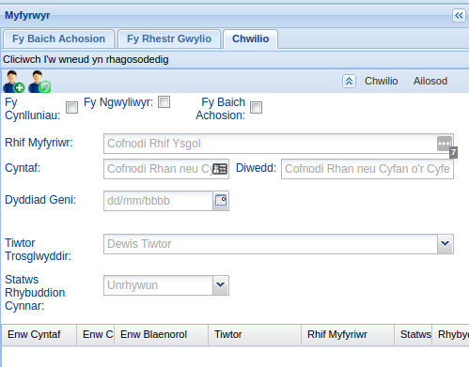
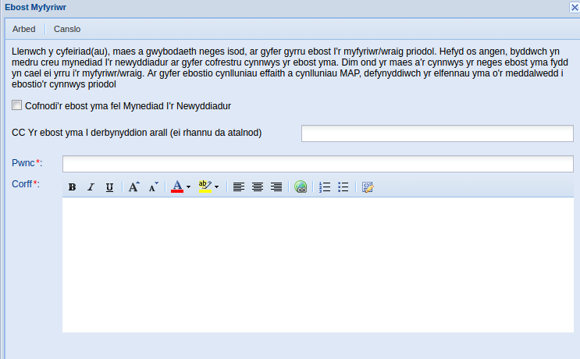
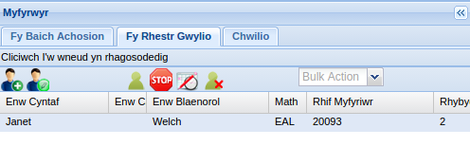
Intervention Management
UNICON Student Success Planner
Case & Intervention Management
Excel translation files (includes duplicate) of ~ 550 terms
~ 10 Email templates (HTML format)
UDD 1.2 fields/ mappings sourced, thus require translation

Slide 6
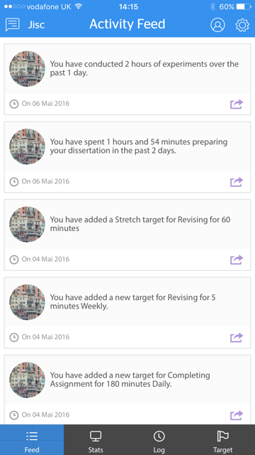
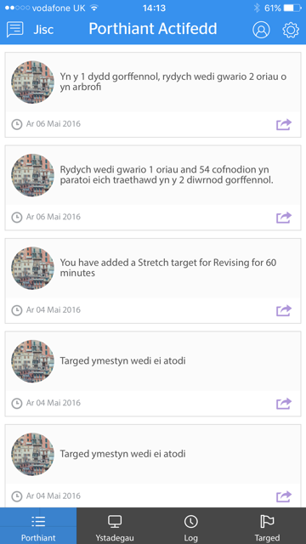
Student App Myfyrwyr
Learning Analytics Student App
Apple iOS devices (v8+)
Android devices (v4.2+, min 1GB RAM)
Single excel translation file (includes duplicates) of 271 terms - so far!
UDD 1.2 fields/ mappings sourced, thus require translation
Currently finalising LRW & student data model (UDD) integration for final beta version release

Slide 7
Contact/ Cyswllt
Rob Wyn Jones
Learning Analytics/ Dysgu Dadansoddol
rob.jones@jisc.ac.uk/ 07976 508860

