Slide 1
Digital & Data – The power of Learning Analytics
The key role of relational, student & other data sources in developing Learning Analytics
Notes:
Go to ‘View’ menu > ‘Header and Footer…’ to edit the footers on this slide (click ‘Apply’ to change only the currently selected slide, or ‘Apply to All’ to change the footers on all slides).
To change the image on this slide:
Click once on the image to select it, and then delete it
Drag a replacement picture to the placeholder or click the icon in the centre of the placeholder to browse for & add another image
Once you have added your replacement image, you may need to put it into the background so that it doesn’t cover other items on the slide. Do this by right-clicking on the new image and choosing ‘Arrange’ > ‘Send to Back’ from the contextual menu

Slide 2
UDD – Unified Student Data Definition (v1.2.3)
Student data will be sourced to enable all LA services – historical & live data collections
Personal and Professional (academic progression) data, per individual student (HE & FE)
Peace of mind through DPA & Data processing/ access agreement
Structure similar to HESA - a near-subset of the student return (ER, fields, mappings)
Jisc, HESA & UUK = M5
HESA Student Return & LA – no re-inventing wheels!
HEDIIP – align to evolving structures, prepare for future data landscape;
HESA Futures – reduce data collection burden on HEIs, improve data management;
Interventions need to work properly – therefore be timely
Correct (quality) data needs to be captured as frequently as possible
Systems & business processes + data-input efficiency required
https://github.com/jiscdev/analytics-udd/

Slide 3
Let’s talk about data…
Historical data (12-18 months minimum) for a Learning Analytics implementation
Predictive Model Creation (12-36months)
Predictive Model Validation (12months minimum)
Engagement & activity (xAPI) data – VLE (Bb, Moodle), LMS, AMS and more…
Moodle & Bb xAPI live plug-ins for activity, Moodle (log extract) & Bb (Plugin) for xAPI historical
No (or not enough) historical data?
Confirm/ refine retention and data recycling measures
Use other predictive models derived from the project – validate now, create later
Evaluate, influence and co-design other LA service offerings – SSP, Student App, dashboards…
Individual assignment (coursework) and examination marks required per module – with dates!
Data transformation: in-house or using off-the-shelf software tool (Kettle, Alteryx…)

Slide 4
Come and talk to us!
Do you foresee any issues or problems with near-LIVE student data capture or timely data extraction for Learning Analytics?
Are there any resource implications for you, in making Learning Analytics happen at your institution?
Can student assessment information be easily extracted from your system(s) per module/ student? Is the information time indexed?
What other sources/ good indicators of student engagement or activity exist?

Slide 5
Architecture Overview

Slide 6
Architecture Overview

Slide 7
Architecture Overview

Slide 8
Granular View of the Data

Slide 9
UDD

Slide 10
UDD
Assessment Data
Due Dates
Submission Dates
Open Date
Re-assessment
Marks

Slide 11
Top Tips for Data Preparation
Understand where and how you store the information
Aim for the most robust data, not the easiest to extract
Understand how administrative processes are represented in your systems
Consider how you treat special circumstances

Slide 12
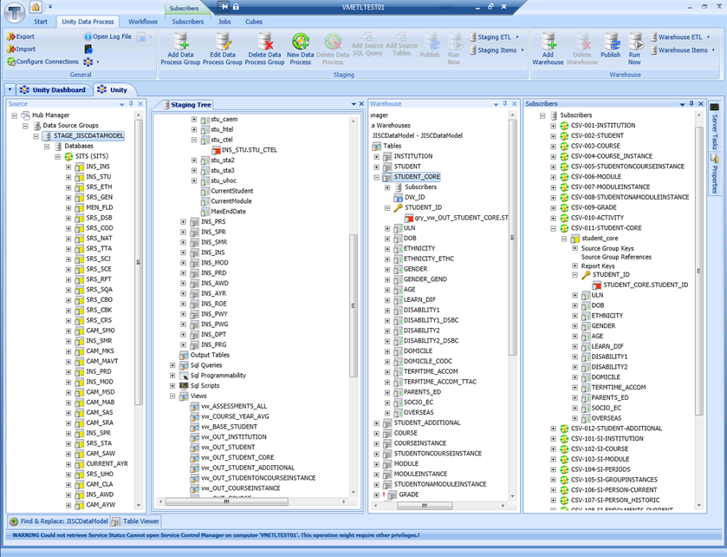
Tribal Specific Slide

Slide 13
Thank you
Rob Wyn Jones – Consultant – JISC Special Projects
Rob.Jones@jisc.ac.uk
Richard Palmer – Tribal – Product Manager, Student Insight
richard.palmer@tribalgroup.com

