Slide 1
How attendance concerns led US to learning analytics
Chris Price
Aberystwyth University

Slide 2
Confession:
I have a superhero alter-ego:
DUGGIE the DOLT

Slide 3
The questions I started from:
Why do we get to week 7, and I am the first person finding out the problems of a fresher who has only been to 10% of his lectures?…
And what can we do to change that?

Slide 4
Emphasis is pastoral

Slide 5
Better questions:
In an age of large classes, how do we keep an eye on all students and know which ones are not “alright”?
This is where are we starting from - how does your institution do this now?
What are the ethical issues to monitoring student attendance and performance?

Slide 6
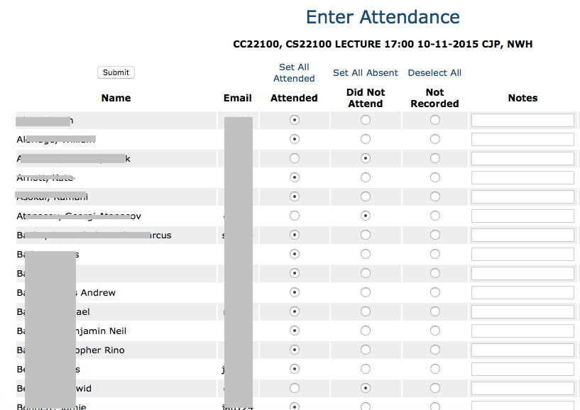
Where we were
Then rely on paper lists / Excel spreadsheets to follow students with concerns

Slide 7
What can we do to improve problem detection?
Automate the recording process
Designed a hand-held attendance recorder based on Arduino
Worked with I.S. to feed data into existing attendance system
Adapted attendance recorder to be fixed in lecture theatres
Rolling out across whole university
Automate the monitoring
Flagging of students whose attendance falls below thresholds
Rapid response and gradual increase in level of response commensurate with severity and duration
Clear picture of attendance and response

Slide 8
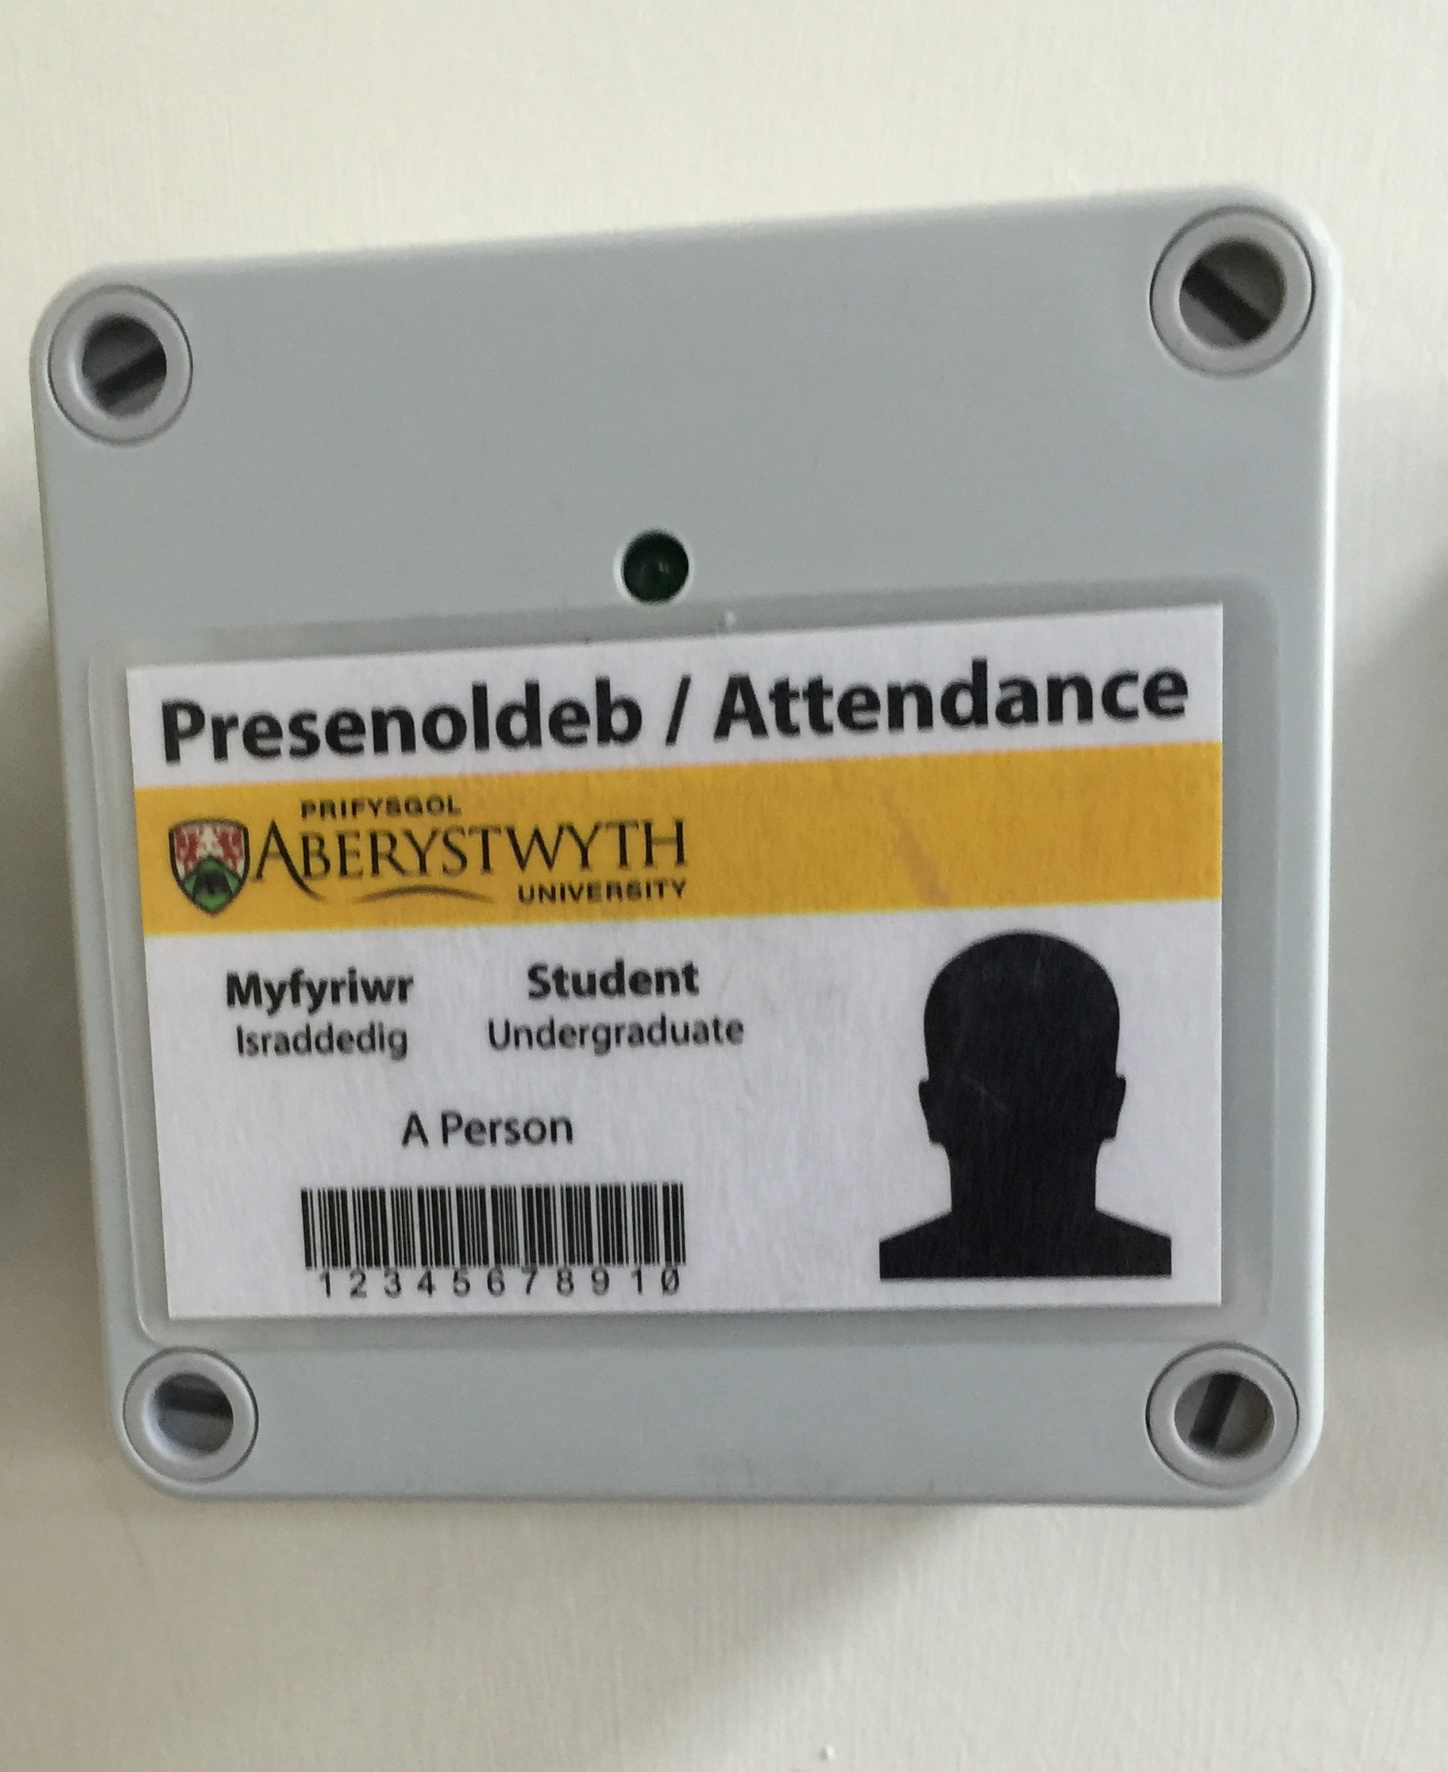
In house Attendance monitor
Cost of around £70 each in bulk
Records all swipes of Aber cards almost instantaneously
4 points in a lecture theatre of 250 works fine
Swipes are looked up and mapped to the student
Student is ticked as attending lecture if swipes within 10 minutes of lecture hour
MUCH improved level of attendance recording

Slide 9
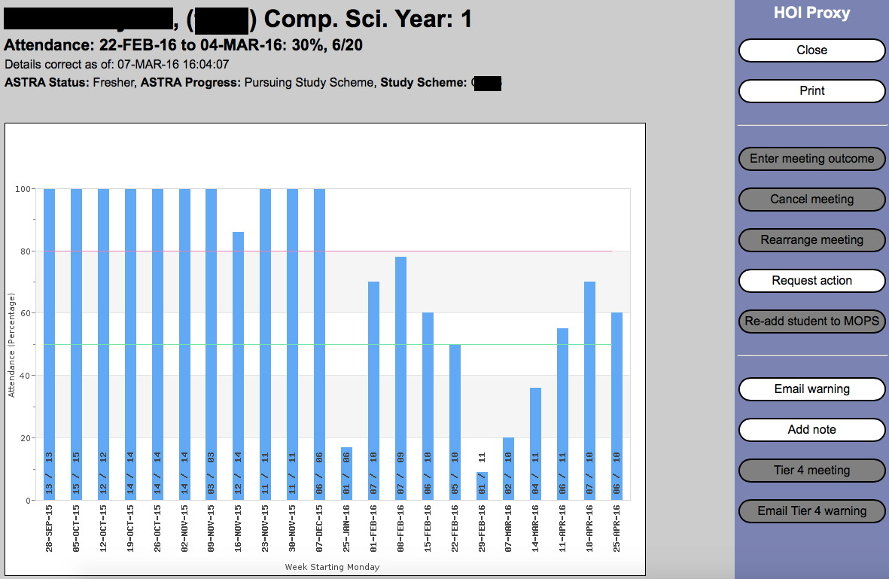
What INDIVIDUAL monitoring looks like (1)

Slide 10
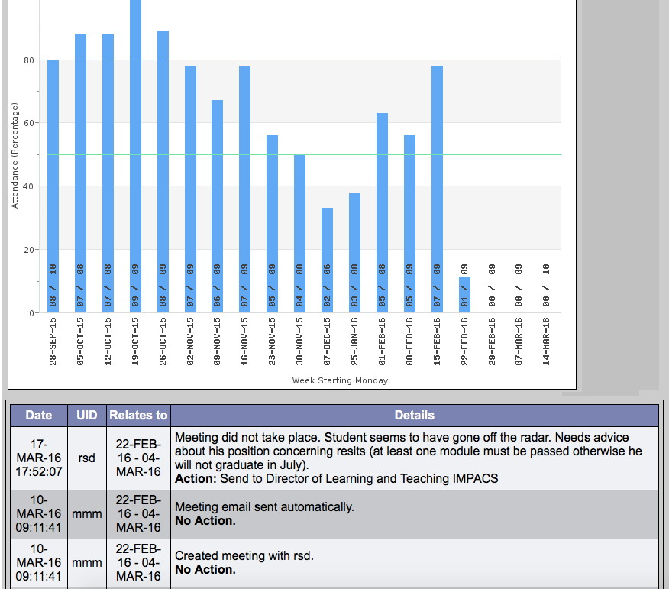
What INDIVIDUAL monitoring looks like (2)

Slide 11
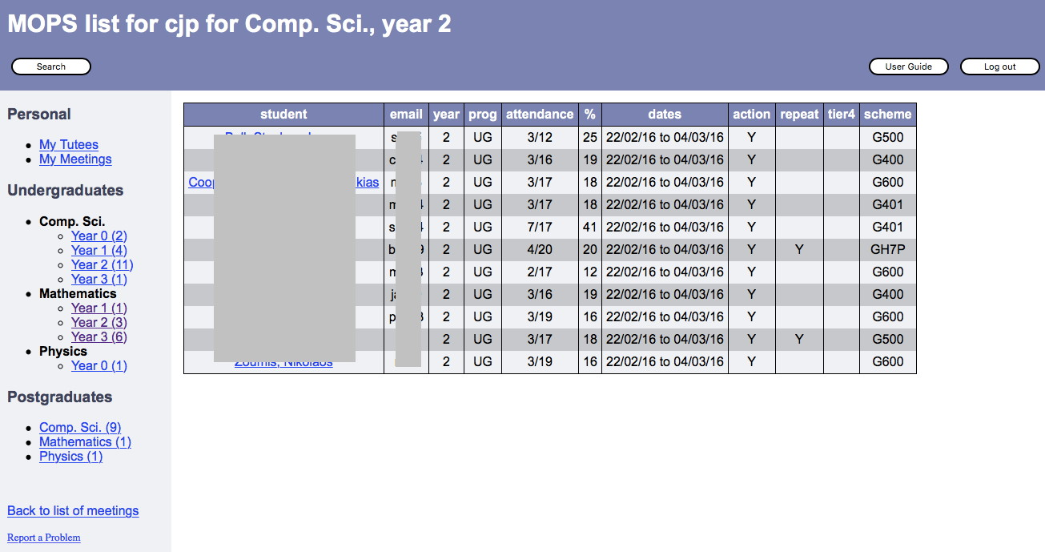
HOW DO YOU know to do INDIVIDUAL monitoring?
Monitor all students and flag those that fall below thresholds
Administrator initiates action depending how bad it is

Slide 12
Levels of Action basED on Attendance and history
Level of concern | Action
Attendance should be better | Email student
Attendance will cause problems or not responded to above | Email to see personal tutor
Absence is causing problems for student | Email to see year / course tutor
Student is not responding to our efforts | Letters to see Duggie the Dolt

Slide 13
Problems with this
Students cheat attendance - not a big problem in practice
Students lie - to themselves and us
Staff don’t do their pastoral jobs - but at least that becomes evident
Suddenly we need a better way of recording absences (we always did, but we didn’t know it)

Slide 14
THE GOOD THINGS this does for us
Lets us respond VERY quickly to drop in attendance
(Mostly) keeps our eye on the ball - we don’t “fire and forget” at students as much as we did
Helps us to monitor students that are in high risk groups more closely
Makes Tier 4 monitoring much easier - it is mostly similar to what we do for other students
All info is in one place, not separate bits of paper
It gives a clear history of what has been done if we need to recommend exclusion
It comes in handy for special circumstances cases

Slide 15
Where it needs improvement
Better information on student participation and academic achievement
Have they been handing in assignments?
What do results so far look like?
Better monitoring so that we pick up performance problems as well as attendance problems
Making information on their attendance / performance available to students

Slide 17
Thank You !
Questions? Comments
Email
cjp@aber.ac.uk

