Slide 1
Learning analytics down under
Associate Professor Cathy Gunn
The University of Auckland, NZ

Slide 2
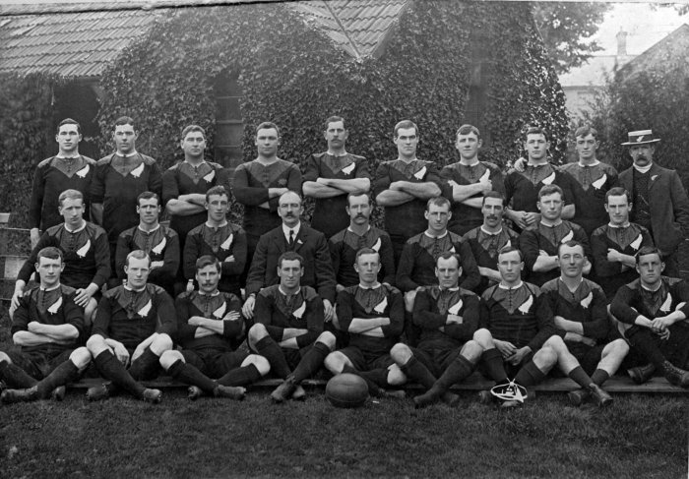
1905 All Blacks Tour Analytics
Matches played: 35 (won 34), Points scored: 976, Points conceded 59
What qualitative data relates this to today’s event?

Slide 3
http://he-analytics.com/

Slide 4
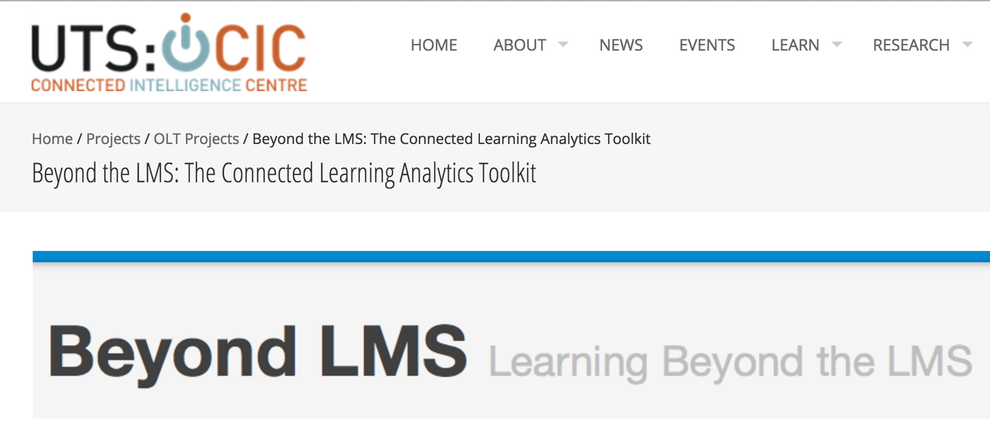
The-connected-learning-analytics-toolkit/

Slide 5
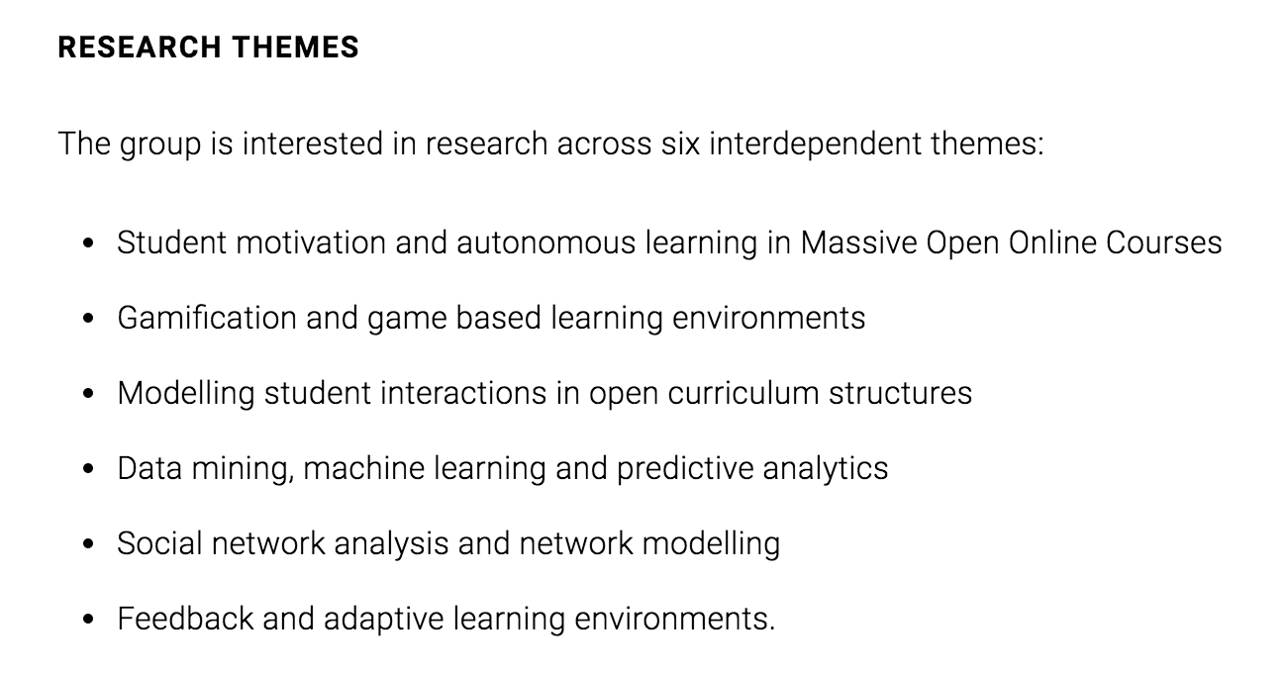
University of Melbourne

Slide 6
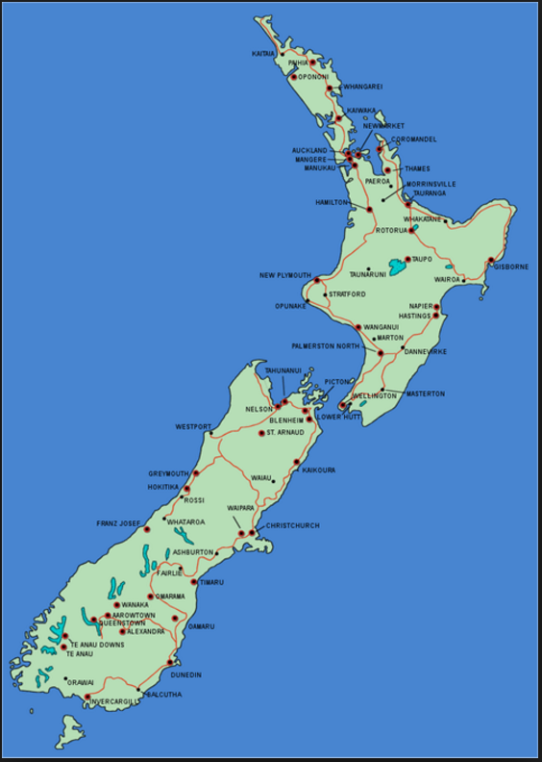
New Zealand
Building an evidence-base for teaching and learning design using learning analytics data
4 institutions, 8 case studies, 15 interviews, 1 survey

Slide 7
Aims
Guide selection and analysis of data to answer learning design questions:
‘Classify’ learning analytics data available through common LMS / VLE and elearning tools
Use analytics data to illuminate relationships between teaching/learning design and learning outcomes
Promote use of “learning intelligence” in course design and evaluation

Slide 8
3 Broad areas:
Student retention ➔ monitor & support progress
Student engagement ➔ observe interactions, understand learning, promote achievement
Student performance ➔ inform design decisions
Key issue = adoption by teachers

Slide 9
Various case studies:
Build a presentation layer for data collected by web course development tool
Refine NLP free text analysis tool
Guidelines for use of LMS / VLE / tool data to monitor learner engagement & achievement
SRES (Student relationship engagement system)
Feedback on course design / better evaluation tools

Slide 10
Survey results show limited understanding
Are you aware of the kinds of data recorded by online learning systems? (n=283)

Slide 11
Survey results show limited understanding
Is it easy for you to a) access and b) interpret learning analytics data? (n=273)

Slide 12
How to promote adoption
Lower barriers to entry
Avoid controversy (while its being sorted out)
Practice based & practice focused approach – to address common questions & challenges
⬇
Scenarios derived from case studies & interviews - adaptable to context, related to teaching practice

Slide 13
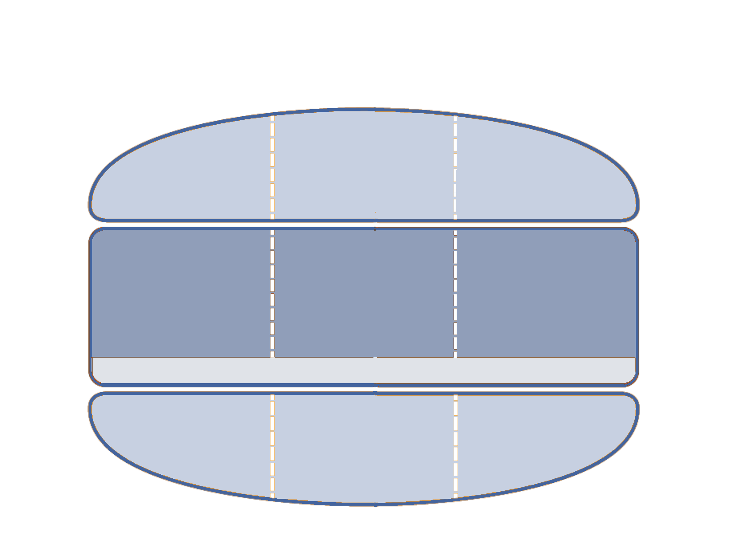
Link use of analytics to learning design cycle
Teach
Facilitate
Assess
Prepare
Plan
Review
Evaluate
BEFORE
DURING
AFTER
Reflection on action
Reflection in action
Reflection on action
Admission data
Learning objectives
Course content
Demographic data
Cohort size
Student feedback
Quiz scores
Assignment grades
Learning challenges
Engagement patterns
Engagement patterns
Grades
Student attendance
Pass rates
Student generated content
Needs analysis
Design
Develop
Implement
Moderate
Review
Evaluate
LEARNING DESIGN

Slide 14
Example scenario: Gain insights into student (mis)conceptions and knowledge
Problem
Students arrive at university with high school passes in subjects they will continue to study
Early success builds false confidence where experience shows common misconceptions and rote learning can lead to failure

Slide 15
Example: Gain insights into student (mis)conceptions and knowledge
Strategy
What - use analytics data to understand what students know, expose common misconceptions, and influence learning strategies
How - a purpose built pre-course test or quiz to offer insights; provide constructive feedback and point to tutorials designed to promote effective learning and knowledge development

Slide 16
Example: Gain insights into student (mis)conceptions and knowledge
Data sources
Analytics report - quiz scores, correct / incorrect answers, number of attempts, use of hints, click through from feedback
Design questions to reveal misconceptions, invite feedback to clarify meaning of quantitative data.
Use discussion, surveys, etc to add a qualitative dimension.

Slide 17
Example: Gain insights into student (mis)conceptions and knowledge
Evaluate and take action
Know what students bring to a course to sharpen the focus of teaching and learning design;
Discuss quiz results with students; explain common misconceptions and pathways to successful study;
Develop online tutorials, monitor use, invite feedback on perceived usefulness

Slide 18
Example: Gain insights into student (mis)conceptions and knowledge
Design implications
Requires a pre-course quiz and tutorials to introduce or revisit subjects previously covered;
Investment of time small relative to benefits of being able to focus on what evidence shows learners need.

Slide 19
Example: Gain insights into student (mis)conceptions and knowledge
Caveats
Misconceptions can be deeply rooted, addressing them may be a long-term process;
Additional strategies might include peer review, frequent quizzes or tests, student designed questions or study resources;
Causal relationships hard to establish, but higher mean grades may be indicative.

Slide 20
Institutional readiness
Address access, acceptable use, policy & practice issues
Foster development of robust reporting tools
Integrate LA into teaching and evaluation practice

Slide 21
Question for discussion
How do we define ‘data’ in this context…
… and who decides?

