Slide 1
Interventions and how to manage them 3 Feb 2016
[Date]
Lindsay Pineda (Unicon)
Patrick Lynch (University of Hull)
Steve Cody (Unicon)

Slide 2
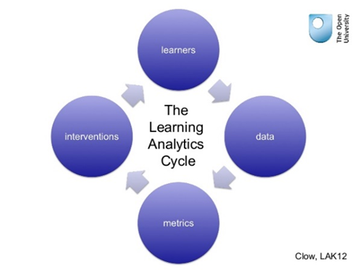
Learning analytics cycle
Notes:
Interventions are about closing the Learning Analytics loop
Doug Clow Open University UK - LAK 2012
LAK '12 Proceedings of the 2nd International Conference on Learning Analytics and Knowledge
Pages 134-138
Leans strongly on learning theories e.g. Kolb & Schon

Slide 3
What is an intervention?
any action that is taken with the intention of improving student outcomes
ideally supported by analytic analysis with measurable outcomes
may be both passive or intrusive, and facilitated by a person or fully automated by a system.
Notes:
Educause Center for Analysis and Research

Slide 4
Interventions - Importance
analytics without action is merely reporting; interventions based on analytics are needed to improve student outcomes
may include setting policies, defining processes, or making referrals for academic or other support services
can be deployed by automated systems that require no direct human input, or may be actively curated by student support professionals
should ideally have a specific, defined outcome and be measurable for effectiveness
Notes:
Educause Center for Analysis and Research

Slide 5
Student Success Plan (SSP)
Intervention Tool

Slide 6
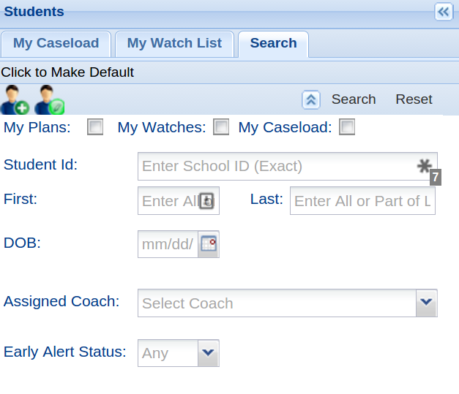
Search for students
Notes:
Advisors (called coaches in SSP) are presented with their personal caseload of students.
Advisors can also search for other students (see search tab in this graphic) as well as add them to a watch list for quick access (see watch tab in this graphic)
Users of the system also have an extensive searching tool to find particular students.

Slide 7
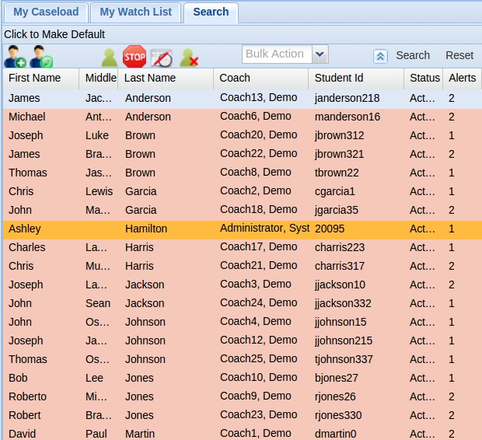
Search for students result set
Notes:
Advisors (called coaches in SSP) are presented with their personal caseload of students.
Advisors can also search for other students (see search tab in this graphic) as well as add them to a watch list for quick access (see watch tab in this graphic)
Users of the system also have an extensive searching tool to find particular students.

Slide 8
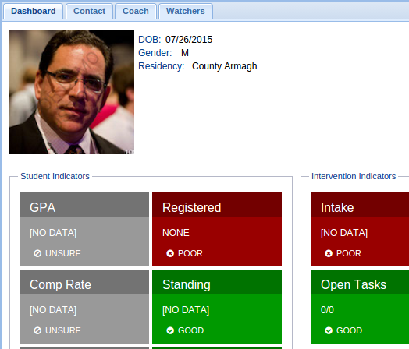
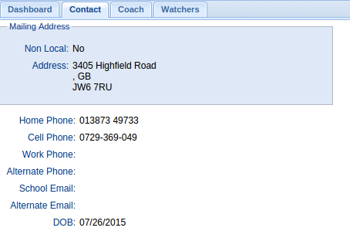
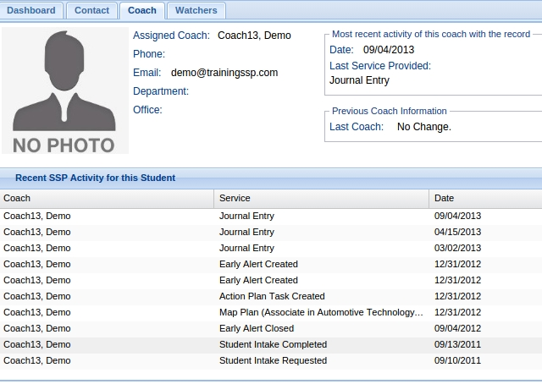
SSP tool set
Notes:
When a student is selected, SSP can act as a dashboard displaying several datapoints about a student, including at risk indicators, general demographic information, transcript information, and coach (advisor) interaction history.

Slide 9
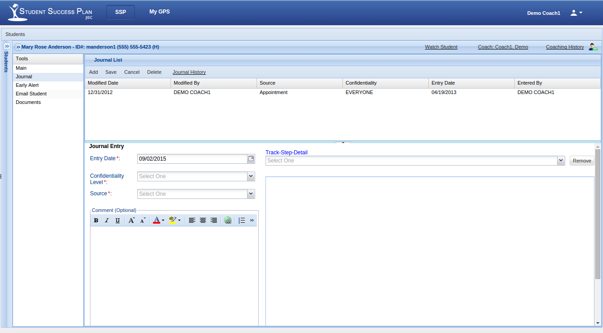
SSP journal
The Journal records notes and actions in the case work for a student
Notes:
The Journal is a log that allows the coach to maintain extra entry information about a student.
Usually information like communications, personal notes, and information about the student’s case can be kept here and is maintained as part of the student’s SSP Record.

Slide 10
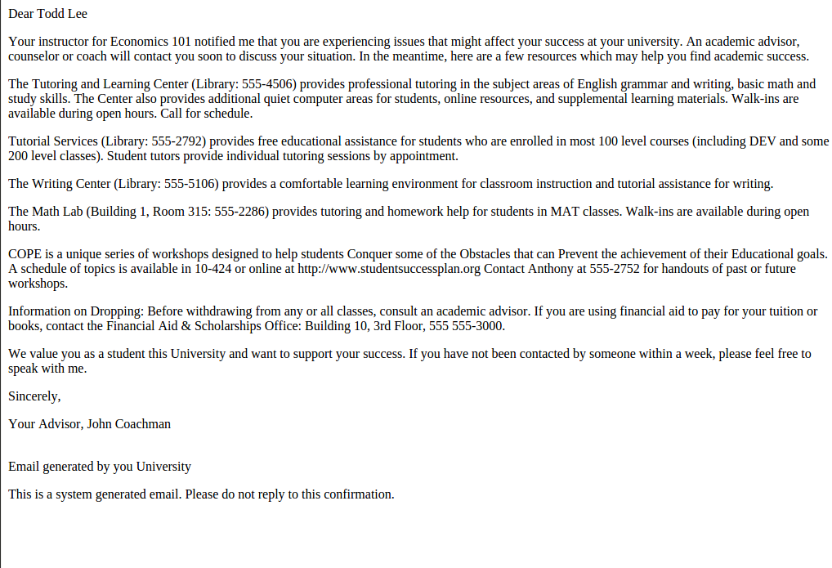
Early alert workflow
Upon receiving an early alert, SSP generates an optional automated email to the coach, student and/or other identified individual.
Notes:
This is a bespoke feature that is included in the Jisc offering but can also be turned off should an institution not desire it.
The text is also bespoke by each institution and can be changed by the institution themselves.
The student, coach and instructor can all get copies of this email to ensure everyone knows what is happening with the student.
10

Slide 11
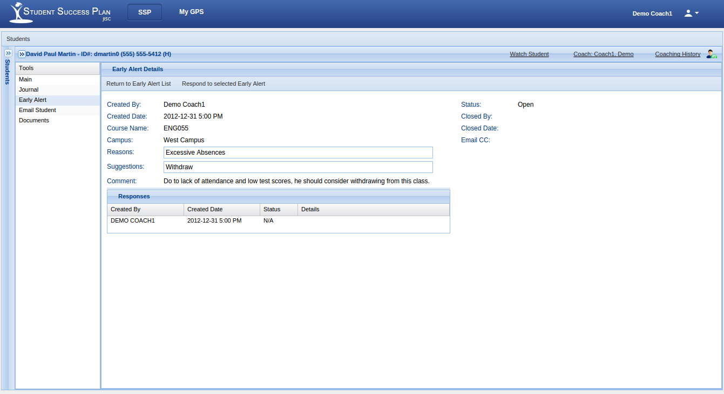
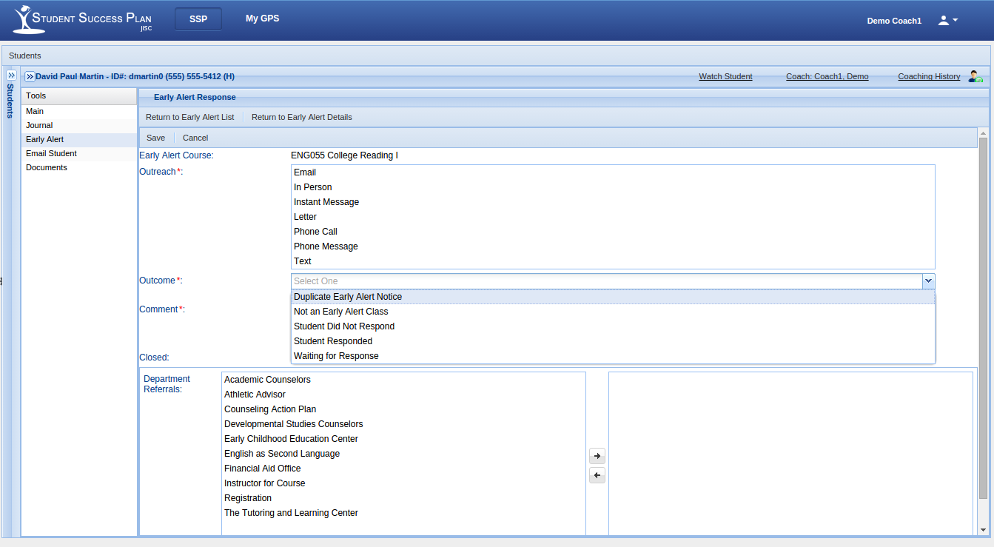
Early alert details and responses
Notes:
Alert details include a history of all responses by a coach.
SSP Allows a Coach to log events called ‘responses’ to an Alert for review and historical purposes.
This could be a response from the student to the coach, from the coach to the student, a conversation with the instructor or any host of other loggable events.

Slide 12
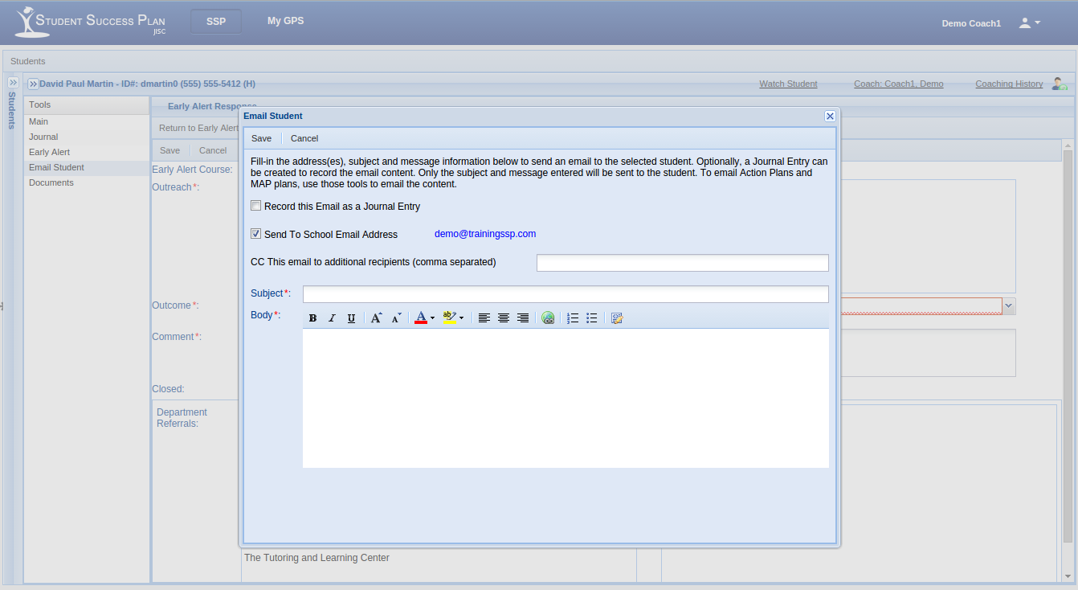
Student communication through SSP
Notes:
SSP makes communication with students simple from within the application.
Communications can also be saved directly to the student’s journal (via the ‘record this Email as a Journal Entry’ checkbox)
This screen displays an email communication, but potentially, SSP can use multiple means of student communication.
Ex – tying in with the student app; sending a message directly from SSP to the App itself
Emails are just one way of communicating

Slide 13
Interventions

Slide 14
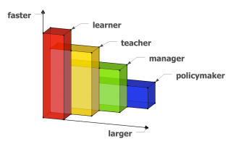
Speed and scale
The scale (horizontal axis) and speed (vertical axis) of intervention readily achieved by different stakeholder groups in a learning analytics system, with proximity to the learning activity (depth axis).
Notes:
As we think more about interventions Doug Clow reminds us about the speed and scale of interventions
learner – anyone engaged in learning
teacher – anyone engaged directly in facilitating learning: includes teaching assistants, associate lecturers, adjunct faculty, faculty, academic staff, and peers in some contexts such as MOOCs
manager – anyone responsible for the organisation or administration of teachers: includes departmental-level and institutional-level management (e.g. managers, administrators, heads of department, Deans, executive officers (CxOs), presidents, provosts, vice-chancellors, rectors and their deputies)
policymaker – anyone responsible for the setting of policy, whether at a local, regional, state, national, or transnational/ intergovernmental level, and including funders.

Slide 15
Managing interventions
Why?
To measure effectiveness of student interventions and intervention strategies
in order to maximise the return on those intervention
providing better outcomes for students
within resource constraints

Slide 16
Considering interventions
5 W’s
Why intervene?
When is an intervention needed? (connections with the student journey) AND
What intervention? (mapping predictions/alerts to interventions – recommenders?)
Targeted
General
Academic general/course specific, Pastoral …
Employability
Where is the intervention – online alert, student only, with personal tutor …
Who is responsible for what in a given intervention?
RACI
Plus:
How do we measure the success of the intervention?

Slide 17
Activity
Divide into groups
Begin discussing the 5 W’s
How will they work at your institution?
What types of interventions are you considering? Why those?
How will you know if your interventions are successful?

Slide 18
Plenary
Sharing out the information discussed

Slide 19
For you to think about
How do you make this work in your institution?
What policies and processes will be affected?
What training will people need?
What ongoing support will be needed for staff and students?

Slide 20
Q&A

Slide 21
Classifying interventions
Why?
To measure, we need to be able to compare
factors of classification (PAR Framework Student Success Matrix):
“The Student Success Matrix (SSMx) gives institutions a means to inventory, organise and conceptualise supports aimed at improving student outcomes. SSMx paves the way to truly understand, measure and bring the correct support to students at the point of greatest impact”
(https://community.datacookbook.com/infowall?institution_id=81&resource_path=%2Finstitutions%2F81%2Fpublic_file%3Fname%3DPAR_SSMx_Summary_Sample_July2013.pdf)
Notes:
Give paper copy of PAR pages
Is this something that Jisc should consider?

